Slide 1
“Phase Shifters”
Semester Project Fall 2022
Department: Electrical Computer Engineering
Group Members: S.M.Shahir.Ul.Haq, S.yousaf Shah, and Waleed Allam
Course: Electrical Circuit Analysis (II)
Subject Teacher : Dr.Atta-ur-Rehman
Lab Teacher:Dr.Hassan Qazi

Slide 2
Contents of Presentation
Background
Introduction
Project task
Selection criteria for components
RC circuit
Circuit Diagram and Block Diagram
Simulation
Project Circuit
Conclusion
Project outcome

Slide 3
Background
Every concept has some background idea behind it and how it started, and phase shifters also have some background behind it in simple words the core concept.
Behavior of Alternating Current
“Alternating Current (AC) is a type of electrical current, in which the direction of the flow of electrons switches back and forth at regular intervals or cycles”
The most familiar AC waveform is the sine wave. alternating currents produced by rotating machinery will naturally be produced in a sinusoidal wave.
So we are dealing with the sinusoidal waveform of AC

Slide 4
Background
Nature of Loads:
The nature of load can be characterized into 3 types
1)Resistive
2)Inductive
3)Capacitive
Resistive:
The kind of circuit or load in which the element is resistor no inductance or capacitance involved and it is the real part of impedance.

Slide 5
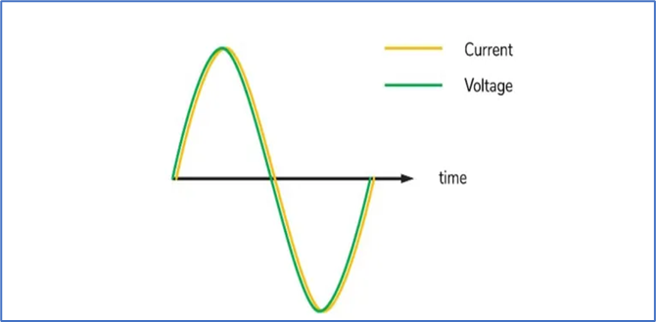
Background
In resistive load the voltage and current are in phase

Slide 6
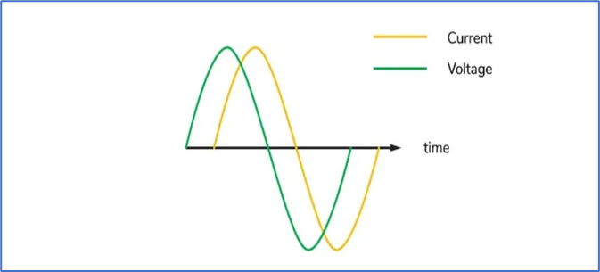
Background
Inductive:
The kind of circuit or load which involves only the inductor no other elements are involved, this is the positive imaginary part of the impedance.
in inductive load or circuit the voltage and current are out of phase by 90 degrees, voltage leads in inductive circuit.

Slide 7
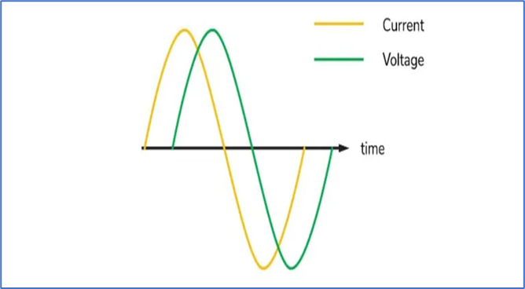
Background
Capacitive:
The kind of circuit or load which involves only a capacitor and no other elements are involved, this is the negative imaginary part of the impedance.
in a capacitive load or circuit, the current and voltage are out of phase by 90 degrees, where the current leads the voltage.

Slide 8
Background
Combined Element Effect:
What would happen when these elements are connected with one another?
Concept of RC, RL and RLC circuit rises
Combine effect of resistance + inductance, and resistance + capacitance typically known as RL and RC
Phase angle between current and voltage is not exactly 90 degrees
Resistive nature of the load attracts the phase toward the real part
The capacitive and inductive behavior of load attract the phase towards imaginary part

Slide 9
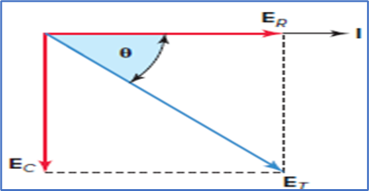
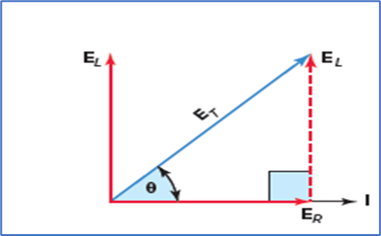
Background
Phasor Diagram for RC and RL:
In this presentation we will be looking at the simple series RC and RL circuit

Slide 10
Introduction
This was the core concept of how V and I angles are re-adjusted according to circuit elements
Phase Shifter is one of the useful applications of RC and RL circuit
Introduction:
Phase Shifter:
“A phase-shifting circuit is often employed to correct an undesirable phase shift already present in a circuit or to produce special desired effects”
RC and RL circuits can be used for this purpose as discussed before

Slide 11
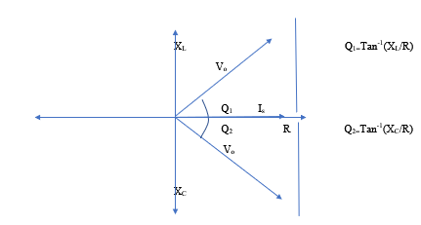
Introduction
Understanding with graph:

Slide 12
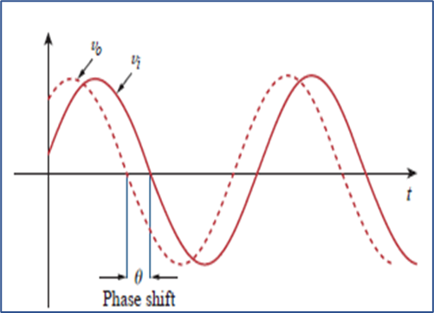
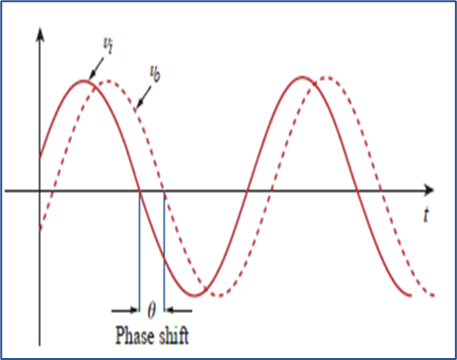
Introduction
RC leading and lagging circuit:
When the output voltage is taken at Resistor then there will be a leading output voltage and when the output voltage is taken at the capacitor then the output voltage will be lagging the input voltage.

Slide 13
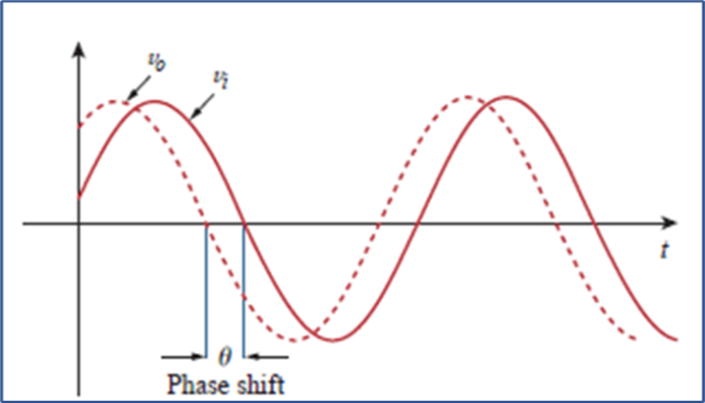
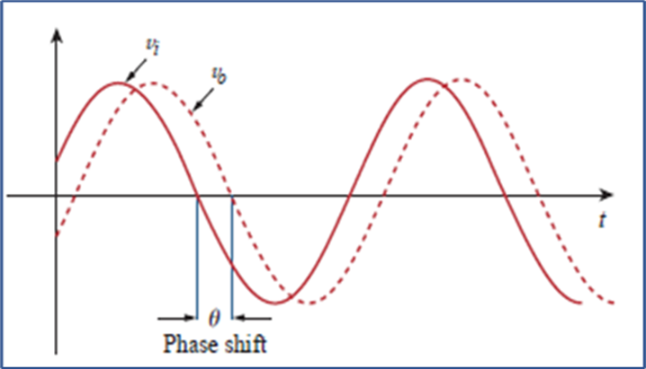
Introduction
RL leading and lagging circuit:
When the output voltage is taken at the resistor then there will be lagging output voltage and when the output voltage is taken at the inductor then the output voltage will be leading the input voltage.

Slide 14
Project
Selection Criteria:
As for the engineering point of view, we must select the components based on efficient selection criteria’s few of them mentioned below
• Manufacturers
• Reference design, software tools or simulation availability
• Less circuit complexity and the same results
• Close to the ideal situation
• Mechanical Parameters [dimension, package, weight, etc.]
• Environmental Parameters: Temperature / Humidity / Pressure / Vibration
• Easily replaceable
• Cost
• Availability

Slide 15
Project
Mathematical Calculations:
Before making any project, it includes some mathematical calculations based on which the components are selected. so in our case, the major components were the resistor and capacitor.
Formula for phase angle=> Q=Tan⁻¹(X/R)
Where X = reactance and R= resistance

Slide 16
Project
Components:
1. 2 pieces 0.33 microfarad capacitors in parallel to get 0.66 microfarad
2. 1 piece 10k ohms variable resistor
3. Step-down transformer 220v to 12v (low wattage components)
4. Breadboard
5. Stripboard circuit board
6. Wiring
7. Oscilloscope for phase angle testing

Slide 17
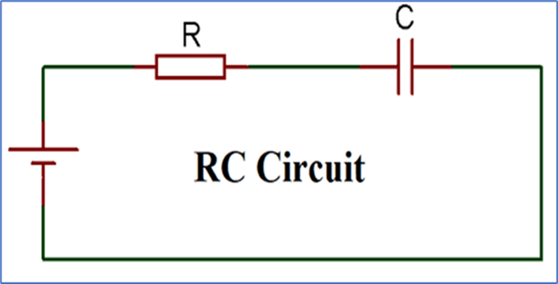
Project
Circuit & Block Diagram:
Simple series RC circuit diagram

Slide 18
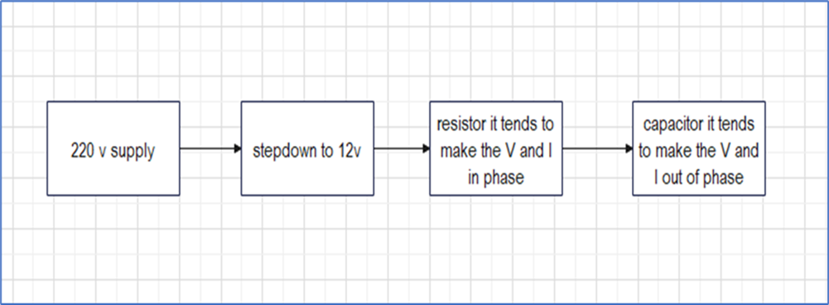
Project
Block diagram for simple series RC circuit:

Slide 19
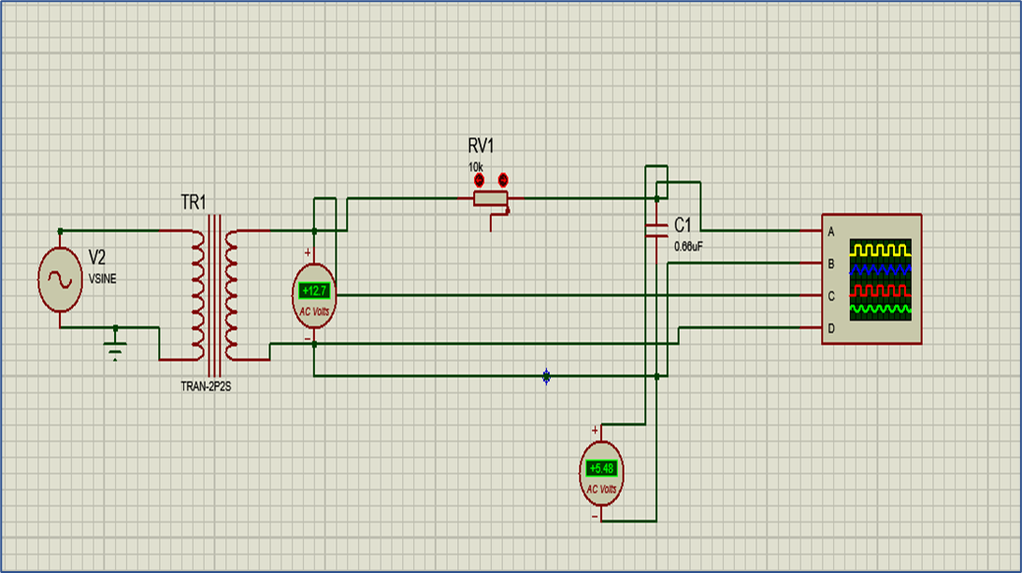
Project
Simulation:
Simulation of the RC series circuit in proteus

Slide 20
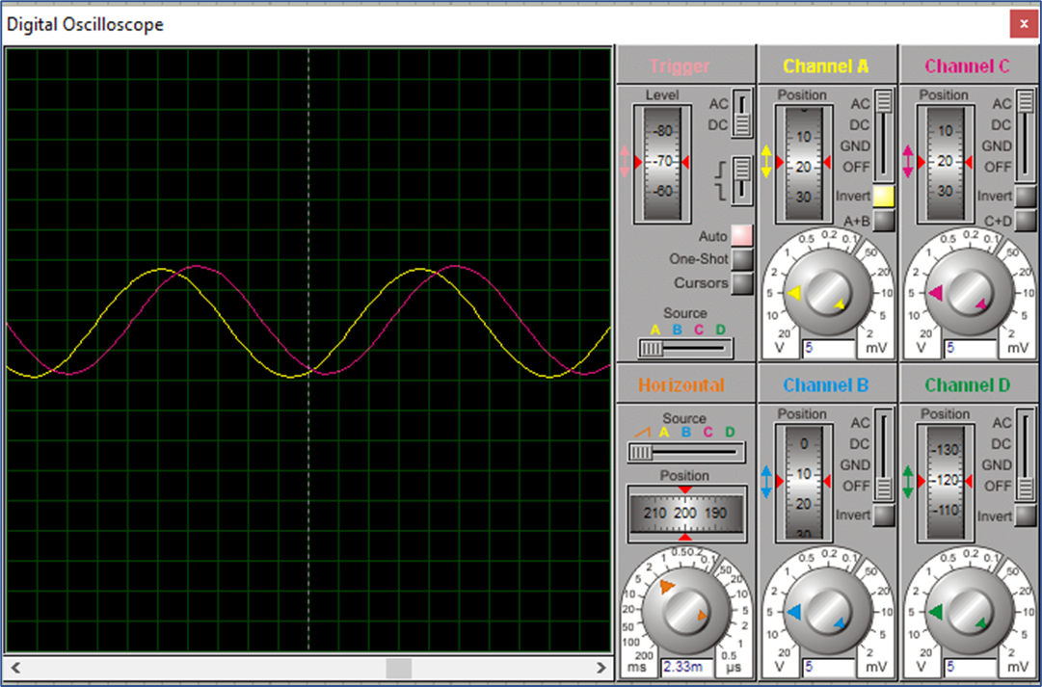
Project
Simulation output:

Slide 21
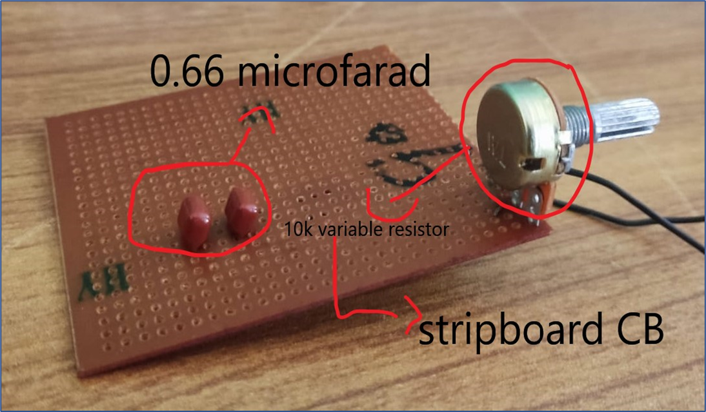
Project
Practical project:
After assembling all components this is how our RC series circuit looks like
Using stripboard circuit board

Slide 22
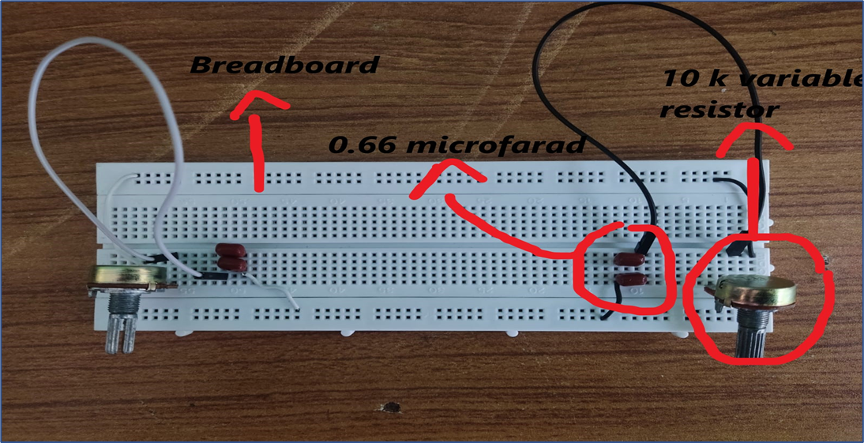
Project
Using breadboard:

Slide 23
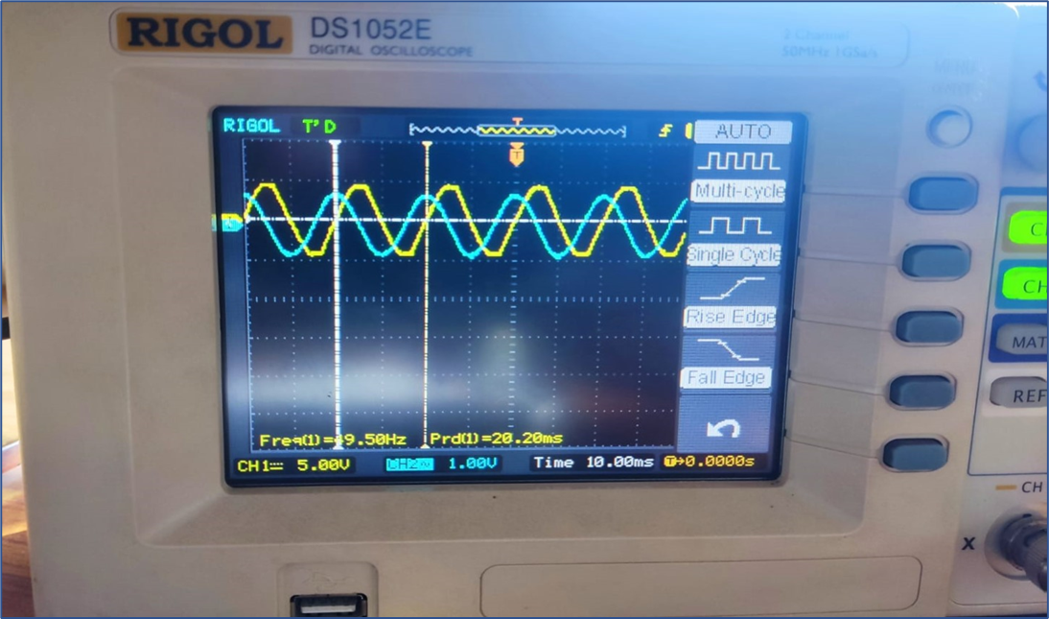
Project
Output:
For the demonstration of phase angles, digital oscilloscope RIGOL DS1052E was used

Slide 24
Project
Calculation of phase angle using oscilloscope:
The graph does not show the direct value of phase angle it has to be calculated
the formula for calculation is as follows Φ = td /tp × 360
Where: td is the delay between waveforms and tp is the period of the waveforms.
For this very output the calculation is as follows:
1 grid = 10 ms, 1 period = 20 ms , 1 small point = 4 ms
Here td=4ms,tp=20 ms => 4/20=0.2*360 = 72 degrees
This is how the calculation is done on the basis of result of the oscilloscope

Slide 25
Conclusion
Phase angle between current and voltage can be changed depending on circuit elements and their values
A phase-shifting circuit is often employed to correct an undesirable phase shift
It can also be used to produce special desired effects
these are simple phase shifters that can have very useful applications
RC and RL simple series and parallel can be used depends on what is the reference or what quantity should be adjusted
Components should be selected keeping the engineering point of view in mind
Simulation tools are very useful to check the circuit connectivity and working before even implementing it physically

Slide 26
Project Outcome
The outcome of this project is very fruitful because it helped us understand the working of AC circuits more
It also boosted our confidence in implementing the circuit practically
While making this project we made mistakes and we learned from our mistakes
This project helped us understand the concept of RC and RL circuits and their application as phase shifters
With this project, we got introduced to the simulation software proteus which will be helpful for future projects as well
Use of an oscilloscope was also a new learning experience
overall it was a good experience making this project

Slide 27
Thanks!!!
Any queries you may ask?

